Slide 1
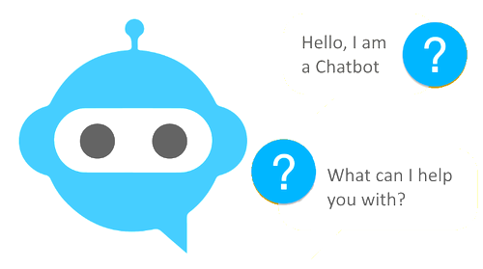
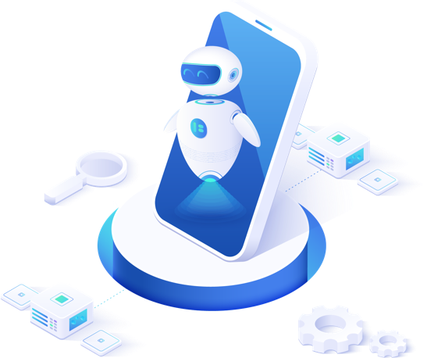
CHATBOT(COVID Helper Bot).
Team - 2 INSIGHT’S
Python Project Team Name’s:
Team Leader: ALEX PAUL.(20BDA66)
1)Ranjith Kumar K.N.(20BDA56)
2)Merin George.(20BDA11)
Date:27-04-2021

Slide 2
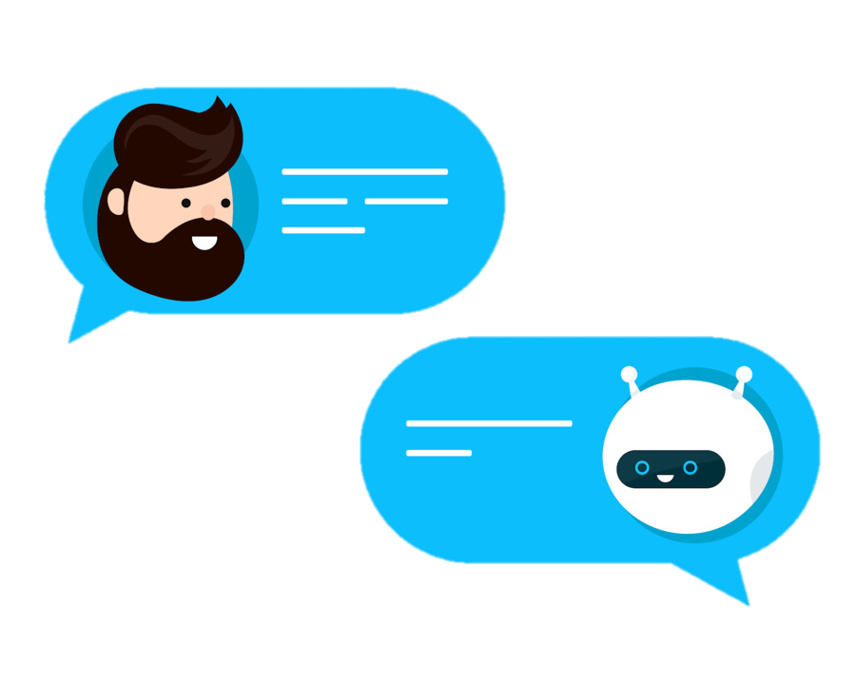
What are chatbots? At the most basic level, a chatbot is a computer program that simulates and processes human conversation (either written or spoken), allowing humans to interact with digital devices as if they were communicating with a real person. How Do Chatbots Work? Driven by AI, automated rules, natural-language processing (NLP), and machine learning (ML), chatbots process data to deliver responses to requests of all kinds. There are two main types of chatbots: - Task-oriented (declarative) chatbots. - Data-driven and predictive (conversational) chatbots.

Slide 3
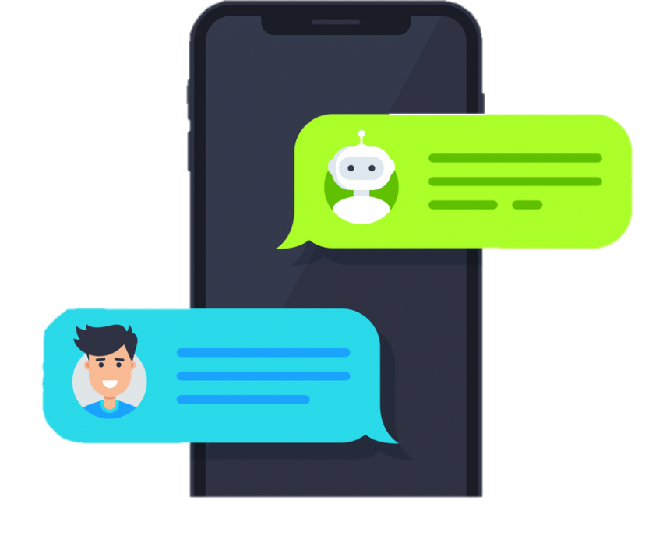
CHATBOT INTEGRATION
We would be creating a Data-driven and predictive (conversational) chat bot for covid19 quires and assistance.
Which would help the users with visualizing country based cases and can take alert calls and message assistance in case of emergencies, can show local of vaccinate places as per to the location, government announcements.
This chat bot is build using :
Dialogflow
Python IDLE
Cloud service
Firebase as backend(Data storing)
Axios for API
S
W
O
T

Slide 4

Natural language processing (NLP) :-
Natural language processing gives machine the ability to ingest the given input, break it down, extract it's meaning , determining appropriate action and answering user in there natural language.
Natural language processing (NLP) has two subsets Natural language understanding (NLU) and natural language generation (NLG).
INTENT’s :-
Intent is a critical factor in chatbot functionality because the chatbot’s ability to parse intent is what ultimately determines the success of the interaction. In order for a chatbot to be good at this, it must:
1. Be programmed well and trained with a useful model involving a lot of training data.
2. Take advantage of machine learning to constantly advance and improve.
ENTITY :-
Entities can be fields, data, or text describing just about anything — a time, place, person, item, number, etc. Using natural language processing (NLP), chatbots can extract entities from entries that users type in in order to turn around accurate recommendations and answers.
EX: @sys.geo.location, @sys.name, @sys.person, @sys.age, @sys.date-time

Slide 5

CHATBOT DIAGRAM REPRESENTATION(chatbot working process):
User
NPL(dialofflow)
Welcome_
intent
EXIT
Parse requests
Check Intent
Help Desk
Show emergency no.
FAQ
3rd Party API
Information
Vaccine registration
Country wise case
Vaccine FAQ
Vaccine Loaction
Covid Screening
Country
Total world wide
Vaccine Info
Vaccine registration
Covid details with age verification
Illness
specifier
Vaccine Appointment
Vaccine Datastore
Vaccine Email Authorizer
Firebase datsStored
5

Slide 6
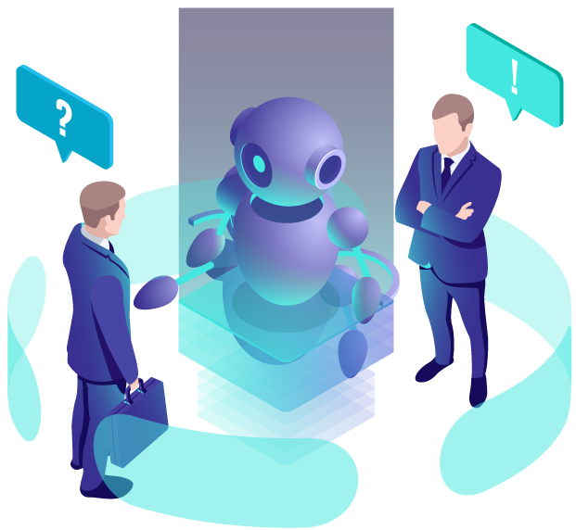
CONCLUSION:
"firebase-admin": "^5.13.1",
"firebase-functions": "^2.0.2",
"dialogflow": "^0.6.0",
"dialogflow-fulfillment": "^0.6.1",
“smtplib": "^4.7.0",
“jason": "^2.4.0",
"axios":"^0.21.1",
"@sendgrid/mail":"^7.4.2",
"nodemailer":"6.5.0"
PACKAGES:
If designed effectively, chatbots may help prevent misinformation, aid in symptom detection, engender infection-limiting behaviors, and lessen the mental health burden of pandemic response. In a pandemic, no group of people remains unaffected for long. Together, patients, healthcare workers, academics, technology companies, NGOs, and governments can ensure chatbots say the right thing.
S
W
REFERENCES:
O
T
Dialogflow> Documentation: Link: https://cloud.google.com/dialogflow/docs
Dialogflow > Python Client : Link: https://googleapis.dev/python/dialogflow/latest/index.html
Intent’s and Entity : Link: https://chatbotsmagazine.com/how-to-document-chatbot-requirements-7df81275cc66
Firebase: Link: https://stackoverflow.com/questions/51692357/how-to-connect-dialogflow-to-cloud-firestore-via-the-inline-editor-in-dialogflow/51715153
NodeMailer: Link: https://stackoverflow.com/questions/48398663/use-nodemailer-in-dialogflow.
Axios: Link:https://github.com/axios/axios.

Slide 7
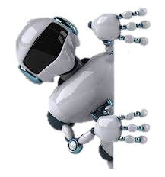
Thank You
Chatbot Demo: http://covidsystems.xyz/
S
W
Team Details:
Team Leader: ALEX PAUL.(20BDA66)
1)Ranjith Kumar K.N.(20BDA56)
2)Merin George.(20BDA11)
O
T

